Slide 1
Odoo Tutorial
Introduction
Development Environment Setup
New Application
Models
Security - A Brief Introduction
Views
Controllers

Slide 2

Introduction
What is odoo
Odoo là một hệ thống ứng dụng mã nguồn mở (a suite of open source business apps)
cung cấp các tính năng cơ bản mà các doanh nghiệp cần: CRM, eCommerce, accounting, inventory, point of sale, project management, etc.
Ưu điểm:
Phát triển đa lĩnh vực (Odoo hiện có hơn 10.000 apps với nhiều lĩnh vực - Thiết kế website, kế toán, CRM, MRP, E-Commerce, chữ ký điện tử, tồn kho, marketing, quản lý điểm bán, dự án, bán hàng, etc..)
Dễ dàng thêm module
Khi sử dụng Odoo / OpenERP, bạn có thể tích hợp thêm các module khác để hoàn thiện và phù hợp với từng đặc điểm kinh doanh doanh nghiệp.
Tiết kiệm chi phí xây dựng
Main Applications
Website Apps
Sales Apps
Finance Apps
Inventory & Manufacturing Apps
Human Resources Apps
Marketing Apps
Services Apps
Productivity Apps
Ref: https://www.odoo.com/page/all-apps
https://vi.wikipedia.org/wiki/Odoo

Slide 3
Development Environment Setup
Có 2 cách setup odoo environment
Install via Github (Hướng dẫn os: ubuntu)
Clone git source code
$ mkdir -p $HOME/src
$ cd $HOME/src
$ git clone git@github.com:odoo/odoo.git
Checkout git branch version
$ git checkout 14.0
Install pip3 and libraries
$ sudo apt install python3-pip python3-dev libxml2-dev libxslt1-dev libldap2-dev libsasl2-dev libssl-dev libpq-dev libjpeg-dev
Install odoo requirements
$ cd $HOME/src/odoo
$ pip3 install -r requirements.txt
Install PostgreSQL
$ sudo apt install postgresql postgresql-client
$ sudo -u postgres createuser -s $USER
Run the server odoo-bin command
$ odoo/odoo-bin --addons-path=./custom,./odoo/addons -r <db_username> -w <db_password> -d <db_name> -u <module> --dev xml
--addons-path: directory của modules
--d: database name
-r: database username
-w: database password
-u: update for module
--dev xml: develop xml mode - không phải restart server khi edit view

Slide 4
Development Environment Setup
Install Odoo via Docker
Install docker: https://docs.docker.com/engine/install/ubuntu/
Install docker compose: https://docs.docker.com/compose/install/
Install Odoo
https://hub.docker.com/_/odoo

Slide 5
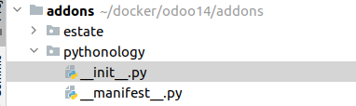
New Application
Prepare addon directory (example: Ubuntu)
Create addons directory
$ mkdir /home/$USER/docker/odoo14/addons
Tạo thư mục addons, nơi lưu các custom modules
Create module directory
$ mkdir /home/$USER/docker/odoo14/addons/pythonology
$ cd /home/$USER/docker/odoo14/addons/pythonology
$ touch __init__.py
$ touch __manifest__.py
Tạo pythonology module trong thư mục custom
Một module bắt buộc phải gồm 2 file __init__.py và __manifest__.py, trong file __manifest__.py là một dict object, bắt buộc có 1 key là name (tên của module
estate/models/property.py
{
'name': 'Pythonology module',
}

Slide 6
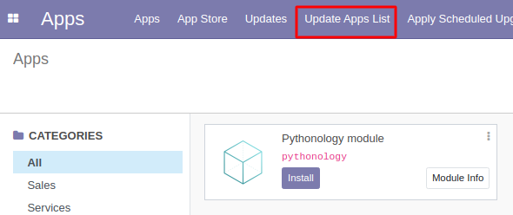
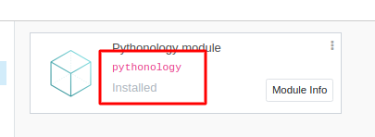
New Application
Install application
Sau khi tạo xong chạy odoo (chạy command trực tiếp nếu cài đặt bằng github hoặc chạy docker)
Truy cập http://localhost:8069/ (8069 port default hoặc tùy config), ở phần application search pythonology
Nếu chưa hiển thị module click Update apps list và search lại (nếu vẫn chưa hiển thị loại bỏ filter app khỏi phần search hoặc config application = True trong file __manifest__.py)
Click install để tiến hành cài module.

Slide 7
Models
Estate model
estate/models/property.py
class PropertyModel(models.Model):
_name = 'estate.property'
_description = 'Property Description'
_order = 'id desc'
name = fields.Char()
description = fields.Text()
estate/models/__init__.py
from . import property
estate/__init__.py
from . import models
Definition
class extend từ models.Model
_name: Bắt buộc. Dấu “ . “ trong giá trị được ORM chuyển thành “_” và lưu thành database table name
Basic Fields
Các basic fields: fields.Char, fields.Integer..
Ref: https://www.odoo.com/documentation/14.0/developer/reference/addons/orm.html#basic-fields
Các fields sẽ được apply vào database khi chạy -u <module_name>. Vdu: -u estate

Slide 8
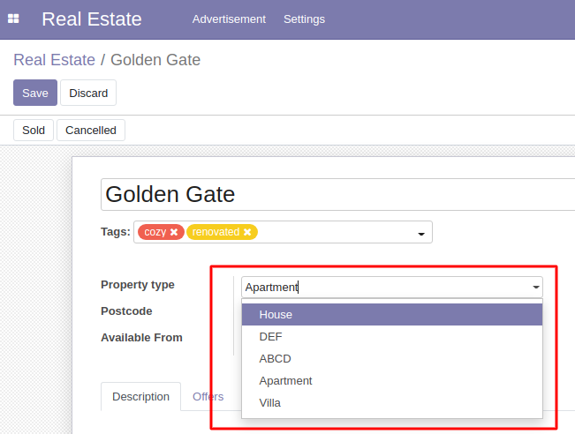
Models
Many2one relation
estate/models/property_type.py
class PropertyTypeModel(models.Model):
_name = 'estate.property.type'
_description = 'Property type description'
name = fields.Char()
estate/models/property.py
class PropertyModel(models.Model):
_name = 'estate.property'
_description = 'Property Description'
name = fields.Char()
description = fields.Text()
property_type_id = fields.Many2one('estate.property.type', string='Property type', ondelete='set null')

Slide 9
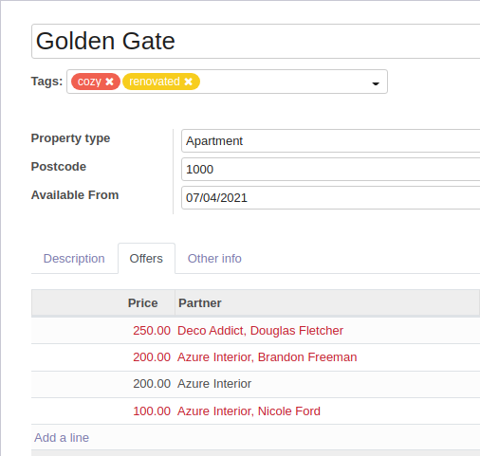
Models
One2many relation
One2many is a virtual relationship, there must be a Many2one field defined in the comodel.
Support for inline view
estate/models/property_order.py
class PropertyOfferModel(models.Model):
_name = 'estate.property.offer'
price = fields.Float()
property_id = fields.Many2one('estate.property', string='Property')
estate/models/property.py
class PropertyModel(models.Model):
. . .
offer_ids = fields.One2many('estate.property.offer', 'property_id', string='Offers')

Slide 10
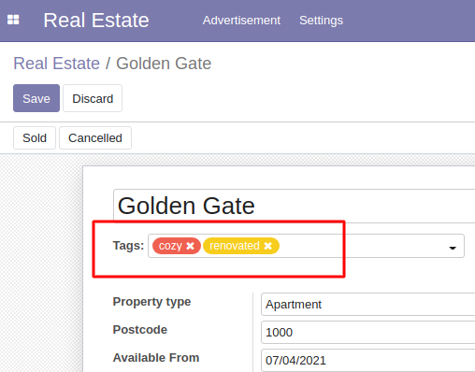
Models
Many2many relation
One2many is a virtual relationship, there must be a Many2one field defined in the comodel.
Support for inline view
estate/models/property_tag.py
class PropertyTagModel(models.Model):
_name = 'estate.property.tag'
name = fields.Char()
color = fields.Integer(default=0)
estate/models/property.py
class PropertyModel(models.Model):
. . .
property_tag_ids = fields.Many2many('estate.property.tag', string='Property tags')

Slide 11
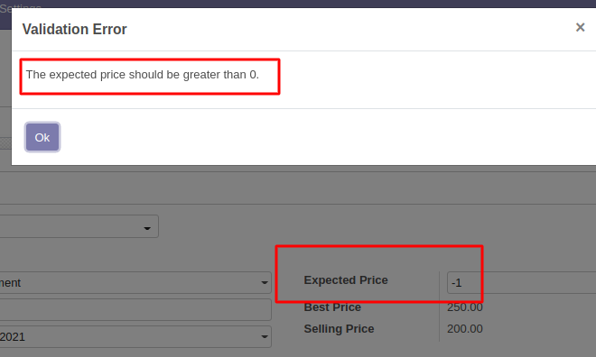
Models
Constraints - Validation
SQL constraints
estate/models/property.py
class PropertyModel(models.Model):
. . .
_sql_constraints = [
('check_positive_expected_price', 'CHECK(expected_price >= 0)',
'The expected price should be greater than 0.'),
('check_positive_selling_price', 'CHECK(selling_price >= 0)',
'The selling price should be greater than 0.'),
]

Slide 12
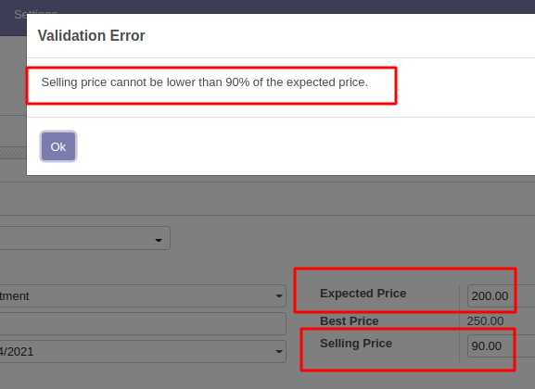
Models
Constraints - Validation
Python constraints
estate/models/property.py
from odoo import api, models, fields
from odoo.exceptions import ValidationError
class PropertyModel(models.Model):
. . .
@api.constrains('selling_price')
def _check_selling_price(self):
for record in self:
if record.selling_price < 0.9 * record.expected_price:
raise ValidationError('Selling price cannot be lower than 90% of the expected price.')

Slide 13
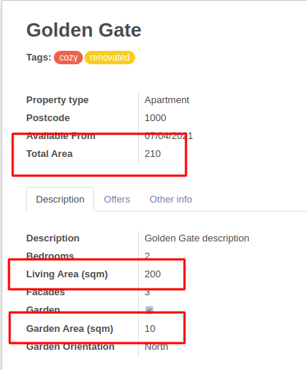
Models
Computed Fields
Dependencies
estate/models/property.py
from odoo import api, models, fields
class PropertyModel(models.Model):
. . .
living_area = fields.Integer()
garden_area = fields.Integer()
total_area = fields.Integer(compute='_compute_total_area')
@api.depends('living_area', 'garden_area')
def _compute_total_area(self):
for record in self:
record.total_area = record.living_area + record.garden_area

Slide 14
Models
Computed Fields
Inverse function
estate/models/property.py
from odoo import api, models, fields
class PropertyModel(models.Model):
. . .
living_area = fields.Integer()
garden_area = fields.Integer()
total_area = fields.Integer(compute='_compute_total_area', inverse='_inverse_total_area')
. . .
def _inverse_total_area(self):
for record in self:
record.garden_area = record.total_area - record.living_area

Slide 15
Models
Onchange
Dữ liệu chưa update vào database
estate/models/property.py
from odoo import api, models, fields
class PropertyModel(models.Model):
. . .
@api.onchange('garden')
def _onchange_garden(self):
if self.garden:
self.garden_area = 10
self.garden_orientation = 'north'
else:
self.garden_area = 0
self.garden_orientation = None

Slide 16
Security - A Brief Introduction
Declare Access Rights
$ cd /home/$USER/src/custom/estate
$ mkdir security
$ touch security/ir.model.access.csv
Những data liên quan tới bảo mật được lưu trong thư mục security
Tất cả các files được odoo sử dụng (data, security, views,...) phải được khai báo trong __manifest__.py trong field “data" theo thứ tự sử dụng
estate/__manifest__.py
'data': [
'security/ir.model.access.csv',
'views/estate_property_views.xml',
'views/estate_property_type_views.xml',
'views/estate_property_tag_views.xml',
'views/estate_menus.xml',
]
Khai báo permission (CRUD) cho group user
ir.model.access.csv
id,name,model_id/id,group_id/id,perm_read,perm_write,perm_create,perm_unlink
access_test_model,access_test_model,model_test_model,base.group_user,1,0,0,0

Slide 17
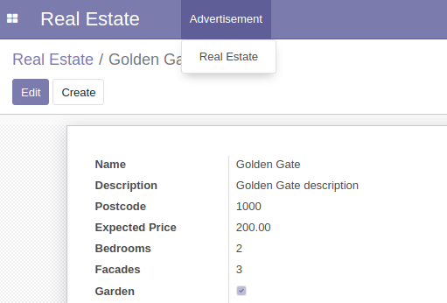
Views
Actions
Actions define the behavior of the system in response to user actions: login, action button, selection of an invoice, …
A basic action for property model
estate/views/estate_property_views.xml
<?xml version="1.0" encoding="utf-8"?>
<odoo>
<data>
<record id="estate_property_action" model="ir.actions.act_window">
<field name="name">Real Estate</field>
<field name="res_model">estate.property</field>
<field name="view_mode">tree,form</field>
</record>
</data>
</odoo>
Basic view mode:
tree: list view
form: detail view

Slide 18
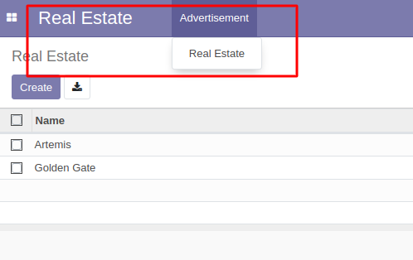
Views
Menus
estate/views/estate_menus.xml
<?xml version="1.0" encoding="utf-8"?>
<odoo>
<menuitem id="estate_dashboard" action="estate_property_action">
<menuitem id="estate_advertisement_menu" name="Advertisement">
<menuitem id="estate_property_menu_action" action="estate_property_action"/>
</menuitem>
</menuitem>
</odoo>

Slide 19
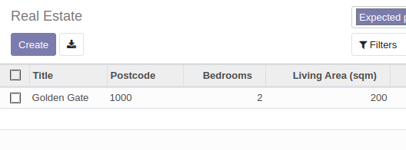
Views
Custom view
Tree - List view
estate/views/estate_property_views.xml
...
<record id="estate_property_list" model="ir.ui.view">
<field name="name">estate.property.list</field>
<field name="model">estate.property</field>
<field name="arch" type="xml">
<tree create="1" delete="1" string="Properties">
<field name="name" string="Title"/>
<field name="postcode"/>
<field name="bedrooms"/>
. . .
</tree>
</field>
</record>
...

Slide 20
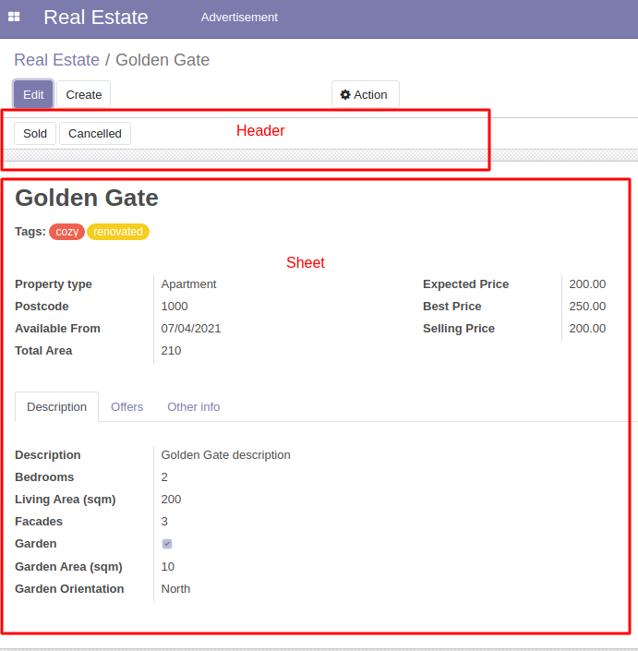
Views
Custom view
Form - Detail view
<record id="estate_property_form" model="ir.ui.view">
<field name="name">estate.property.form</field>
<field name="model">estate.property</field>
<field name="arch" type="xml">
<form string="Property">
<header>
. . .
</header>
<sheet>
. . .
</sheet>
</form>
</field>
</record>

Slide 21
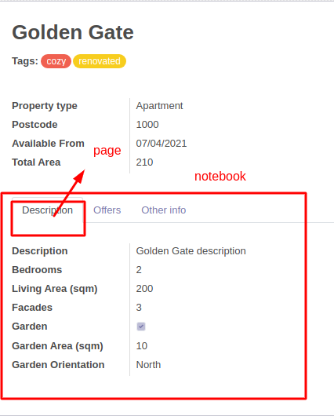
Views
Custom view
Form - Detail view
. . .
<sheet>
. . .
<notebook>
<page string="Description" name="description">
<group>
<field name="description" string="Description"/>
<field name="bedrooms" string="Bedrooms"/>
. . .
</group>
</page>
</notebook>
</sheet>
. . .

Slide 22
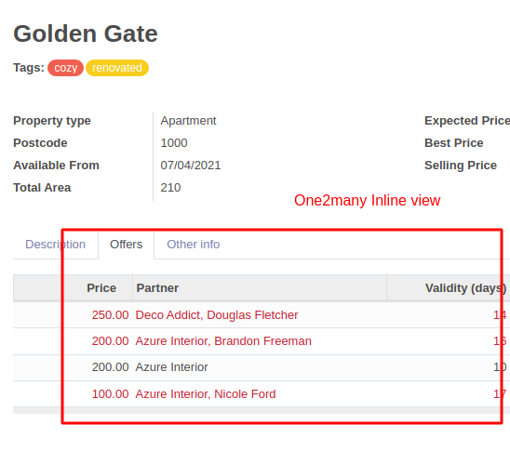
Views
Custom view
Form - Detail view
<notebook>
. . .
<page string="Offers">
<field name="offer_ids" default="{'default_model_id': self}" nolabel="1">
<tree create="1" editable="bottom" decoration-danger="status=='refused'">
<field name="price"/>
. . .
</tree>
</field>
</page>
. . .
</notebook>

Slide 23
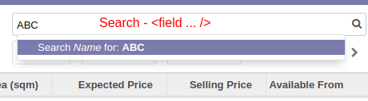
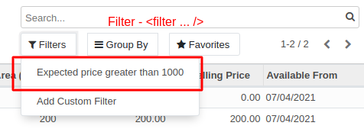
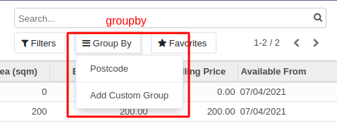
Views
Custom view
Search view
<record id="estate_property_search" model="ir.ui.view">
<field name="name">estate.property.search</field>
<field name="model">estate.property</field>
<field name="arch" type="xml">
<search string="Search property">
<field name="name" filter_domain="[('name','ilike',self)]"/>
<filter name="expected_price_greater_than_1000" domain="[('expected_price','>=',1000)]" string="Expected price greater than 1000"/>
<group expand="0" string="Group By">
<filter name="postcode" domain="" context="{'group_by':'postcode'}"/>
</group>
</search>
</field>
</record>

Slide 24
Views
Custom action
estate/models/property_offer.py
from odoo import api, models, fields
from odoo.exceptions import UserError
class PropertyOfferModel(models.Model):
. . .
def accept_offer(self):
for record in self:
if record.property_id.status != 'open':
raise UserError('Sold or Cancelled property cannot accept offer.')
record.property_id.partner_id = record.partner_id
record.property_id.selling_price = record.price
record.property_id.status = 'sold'
record.status = 'accepted'
Custom action
<button name="<function_name>" string="<display>" type="object"/>
function_name: function gắn với action của model
estate/views/estate_property_views.xml
. . .
<page string="Offers">
<field name="offer_ids" default="{'default_model_id': self}" nolabel="1">
<tree create="1" editable="bottom" decoration-danger="status=='refused'">
. . .
<button name="accept_offer" string="Accept" type="object" icon="fa-check"/>
<button name="refuse_offer" string="Refuse" type="object" icon="fa-times"/>
</tree>
</field>
</page>

Slide 25
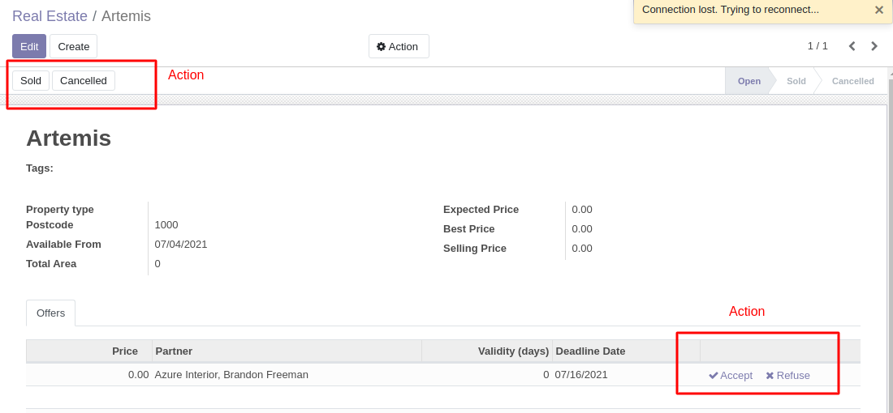
Views

Slide 26
Views
Template Engine
Ref: https://www.odoo.com/documentation/14.0/developer/reference/javascript/qweb.html#reference-qweb

Slide 27
Controllers
Trong trường hợp cần mở rộng thêm các view:
estate/controllers/mycontroller.py
from odoo.http import Controller, route
class MyController(Controller):
@route('/some_url', auth='public')
def handler(self):
return "{'response': 'OK'}"
estate/controllers/__init__.py
from . import mycontroller
estate/__init__.py
from . import controllers
For more detail: https://www.odoo.com/documentation/14.0/developer/reference/addons/http.html
http://localhost:8069/some_url/
=> {'response': 'OK'}

Slide 28
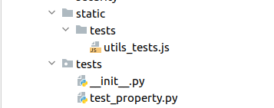
Testing Odoo
To write tests, simply define a tests sub-package in your module, it will be automatically inspected for test modules. Test modules should have a name starting with test_ and should be imported from tests/__init__.py, e.g.
Testing Python code
Run testing
Run all module tests
$ odoo/odoo-bin . . . -i estate --test-enable
Run all the tests in this file
$ odoo/odoo-bin . . . --test-file=customs/estate/tests/test_property.py
Filter which tests to execute
$ odoo/odoo-bin . . . --test-tags=/estate:EstateTestCase.test_creation_area
Writing a test
Odoo provides support for testing modules using unittest.

Slide 29
Testing Odoo
All the tests should extend odoo.tests.common.SavepointCase. You usually define a setUpClass, and the tests. After doing the setUpClass, you have an env available on the class and can start interacting with the ORM.
Một số Model test case khác:
TransactionCase (run transaction for each test method - SavepointCase: run transaction for each instance and run sub-transaction for each test method)
HttpCase: test case with urlopen and Chrome
More detail:
https://www.odoo.com/documentation/14.0/developer/howtos/rdtraining/E_unittest.html#modules
https://www.odoo.com/documentation/14.0/developer/reference/addons/testing.html#testing-python-code
@tagged('at_install')
class EstateTestCase(SavepointCase):
@classmethod
def setUpClass(cls):
super(EstateTestCase, cls).setUpClass()
cls.properties = cls.env['estate.property'].create([
{'name': 'Test Estate Property'},
{'name': 'Test Estate Property 2', 'garden_area': 10},
])
def test_creation_area(self):
self.properties.living_area = 20
self.assertRecordValues(self.properties, [
{'name': 'Test Estate Property', 'total_area': 10},
{'name': 'Test Estate Property 2', 'total_area': 30},
])

Slide 30
Testing Odoo
odoo.define('estate.utils_tests', function (require) {
"use strict";
function add(a, b) {
return a + b;
}
QUnit.module('estate', {}, function () {
QUnit.module('test add', {}, function () {
QUnit.test('add two numbers', assert => {
assert.expect(2)
assert.strictEqual(add(1, 1), 2);
assert.strictEqual(add(1, 3), 4);
});
});
});
});
Testing JS code
These tests stay in the browser, and are not supposed to reach the server.
Các bước viết một js test:
Viết test case trong file static/tests/<test case name>.js
The Odoo framework uses the QUnit library testing framework as a test runner. QUnit defines the concepts of tests and modules (a set of related tests), and gives us a web based interface to execute the tests.
https://qunitjs.com/intro/
Add file vào main test assets

Slide 31
Testing Odoo
estate/assets.xml
<?xml version="1.0" encoding="utf-8" ?>
<odoo>
<template id="qunit_suite_tests" name="estate tests" inherit_id="web.qunit_suite_tests">
<xpath expr="//script[last()]" position="after">
<script type="text/javascript" src="/estate/static/tests/utils_tests.js"/>
</xpath>
</template>
</odoo>
estate/__manifest__.py
'data': [
'assets.xml',
. . .
],
Testing JS code
Add file vào main test assets
Khai báo assets file vào __manifest__.py
Chạy test bằng browser
Truy cập: http://localhost:8069/web/tests
Chọn module cần test hoặc chạy tất cả test theo default.

